Slide 1
AI-Powered Retail Analytics Using Object Detection
Team 9: Kunal SomendraSingh, Hitarth Chopra & Tejas Singhal

Slide 2
Agenda
Motivation and Problem Definition
Project Objectives
Baseline and Related Work
Method
Datasets
Results
Demonstration
Conclusion and Discussion

Slide 3
Motivation and Problem Definition
Shopping feels effortless—but it hides complex backend challenges.
Store managers need insights beyond sales—behavior, trends, and anomalies.
Current theft detection? Hours of CCTV review—manual, slow, unsustainable.
Marketing teams rely on outdated methods—surveys, observations, guesswork.
Customer behavior data is hidden in carts—unseen until checkout.
Retailers lack real-time visibility into what’s picked and when.
Our solution: AI-powered, real-time cart, shelf and store monitoring to bridge this gap.

Slide 4
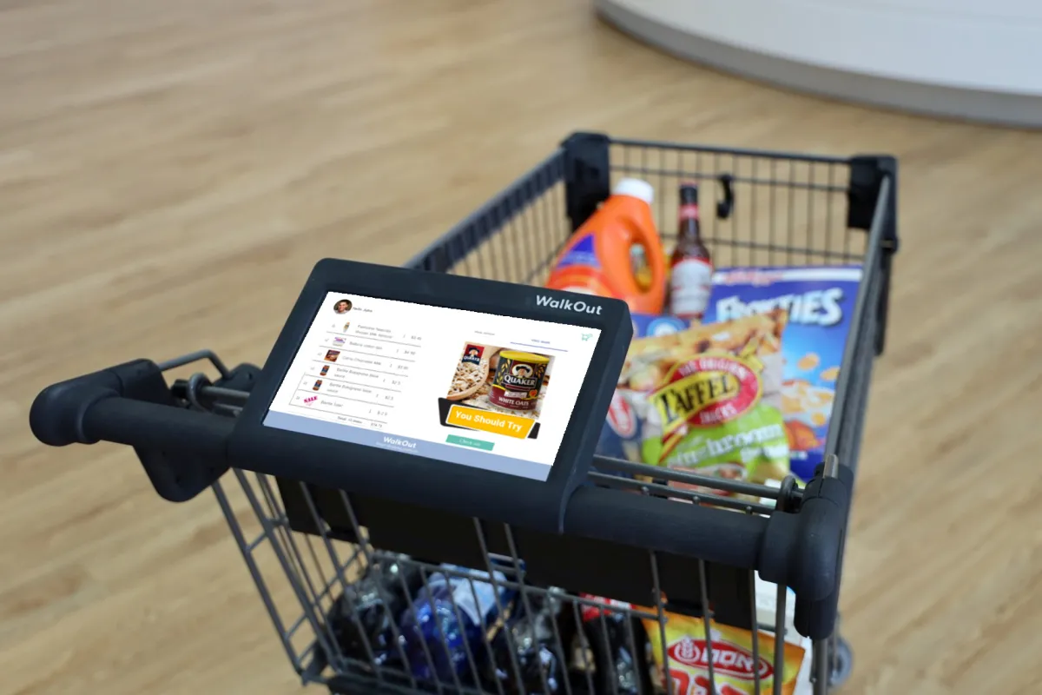
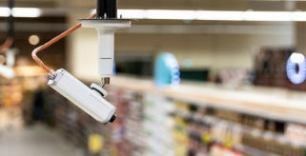
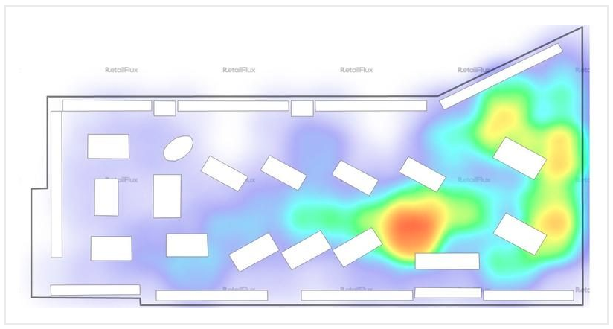
Project Objectives
In this project we aim to make retail better via 3 ways:
Cart Detection
2. Shelf Monitoring
3.Store Foot-Traffic Analyzer

Slide 5
Baseline & Related Work
Related Work
Baseline Methods
Object Detection in Shelf Image of the Retail store using Single Stage Detector.
ByteTrack: Multi-Object Tracking by Associating Every Detection Box
Revolutionizing Retail Unleashing the Power of Yolo for Product Detection
YOLOv8 initialized from Ultralytics for object detection and classification in images.
Classic Trackers which using contouring and background subtraction for person detection whilst leveraging using YOLO Models.
Yolox_s used for video processing and object detection.

Slide 6
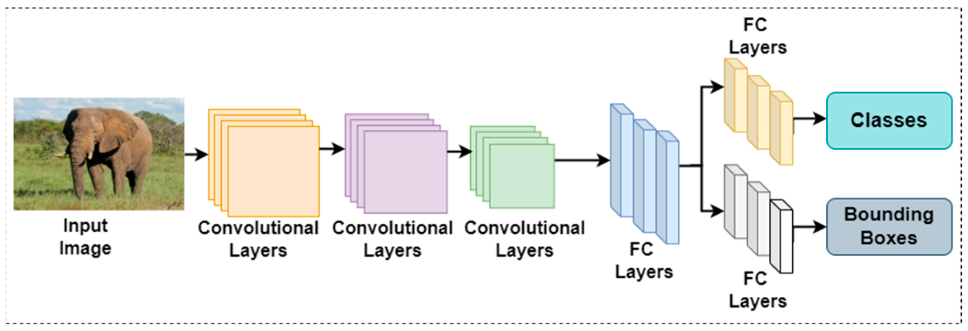
Method
YOLO divides the input image into a grid and predicts bounding boxes and class labels simultaneously in a single forward pass, enabling real-time performance.
The model uses convolutional layers to extract spatial features, followed by fully connected (FC) layers.
YOLO is ideal for retail use cases like shelf monitoring and smart cart detection, as it can process video frames in real-time and be easily fine-tuned to specific store products.

Slide 7
Method
Cart Counting
Person Detection
Shelf Counting
Use video streams from smart carts equipped with cameras.
YOLO training pipelines are used with Roboflow-style datasets.
Train a YOLONAS Small model to detect products as they are placed into the cart.
Track product pickup frequency and generate real-time basket content.
Frames are passed through the YOLOv8 detector where YOLO outputs bounding boxes with confidence scores.
High confidence tracks are matched with existing tracks and Remaining tracks are then matched to low-confidence detections.
Each tracked person is assigned a persistent ID across frames.
Movements from zones are tracked across IDs.
Utilise YOLOv8 Model and fine-tune on retail shelf images for object detection.
Validate the results for object detection and classification(55 class retail dataset).
Compare “before” and “after” shelf images to infer sales and restock needs.
Provide per-class count statistics and visual results for store staff.

Slide 8
Datasets
Roboflow image data with 27 classes - Apples, Banana, Milk, Oil, etc. The model is then trained and fine tuned for object detection for Cart shopping objective.
Roboflow people counting Data for image/frame analysis fine tuned for person detection objective.
Custom Retail shelf image dataset of annotated shelf images (55 classes) used for fine tuning Shelf product detection.

Slide 9
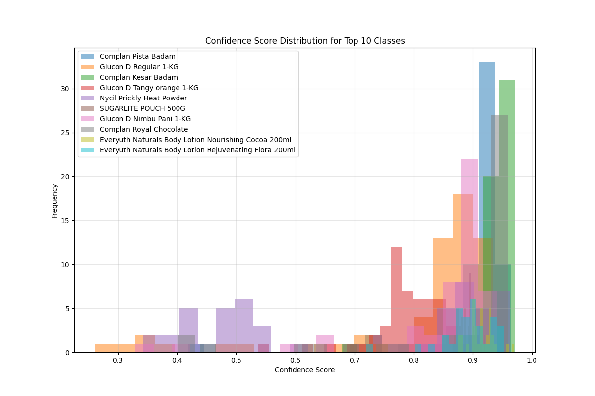
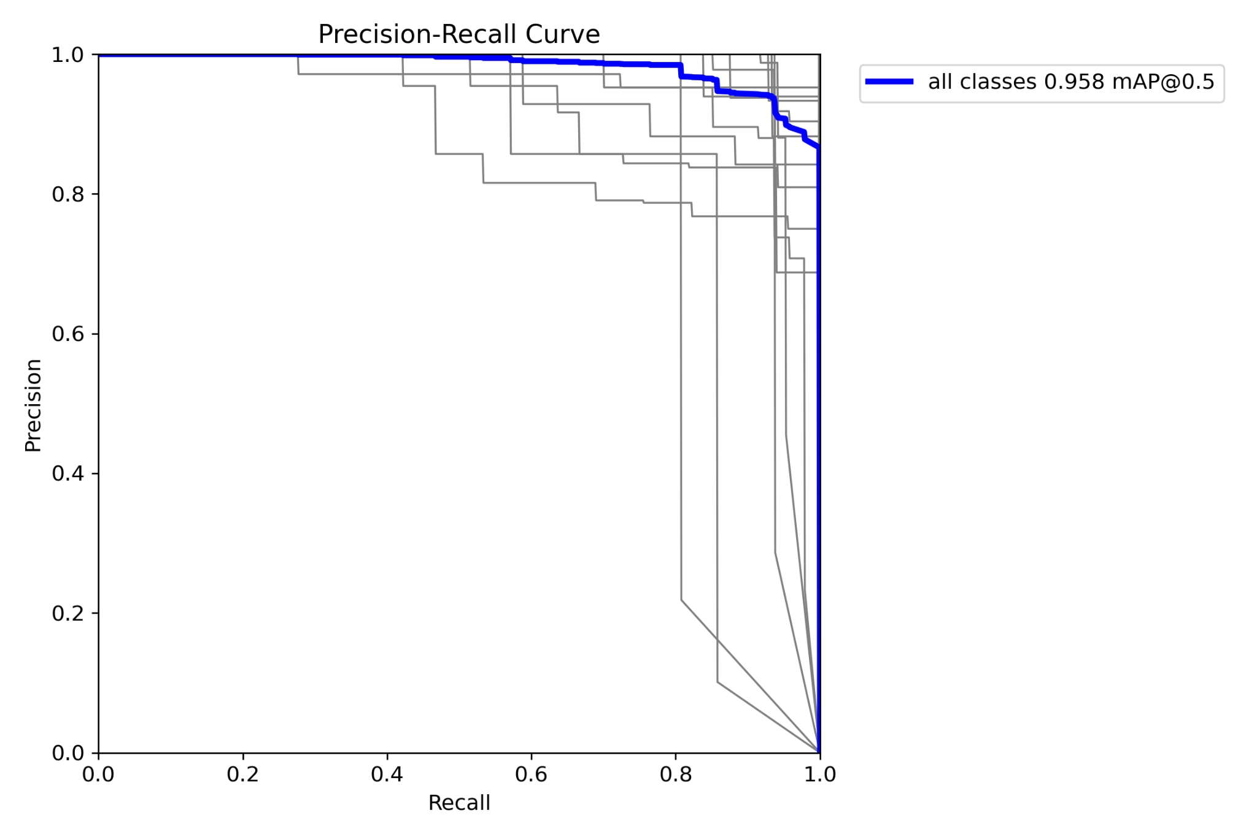
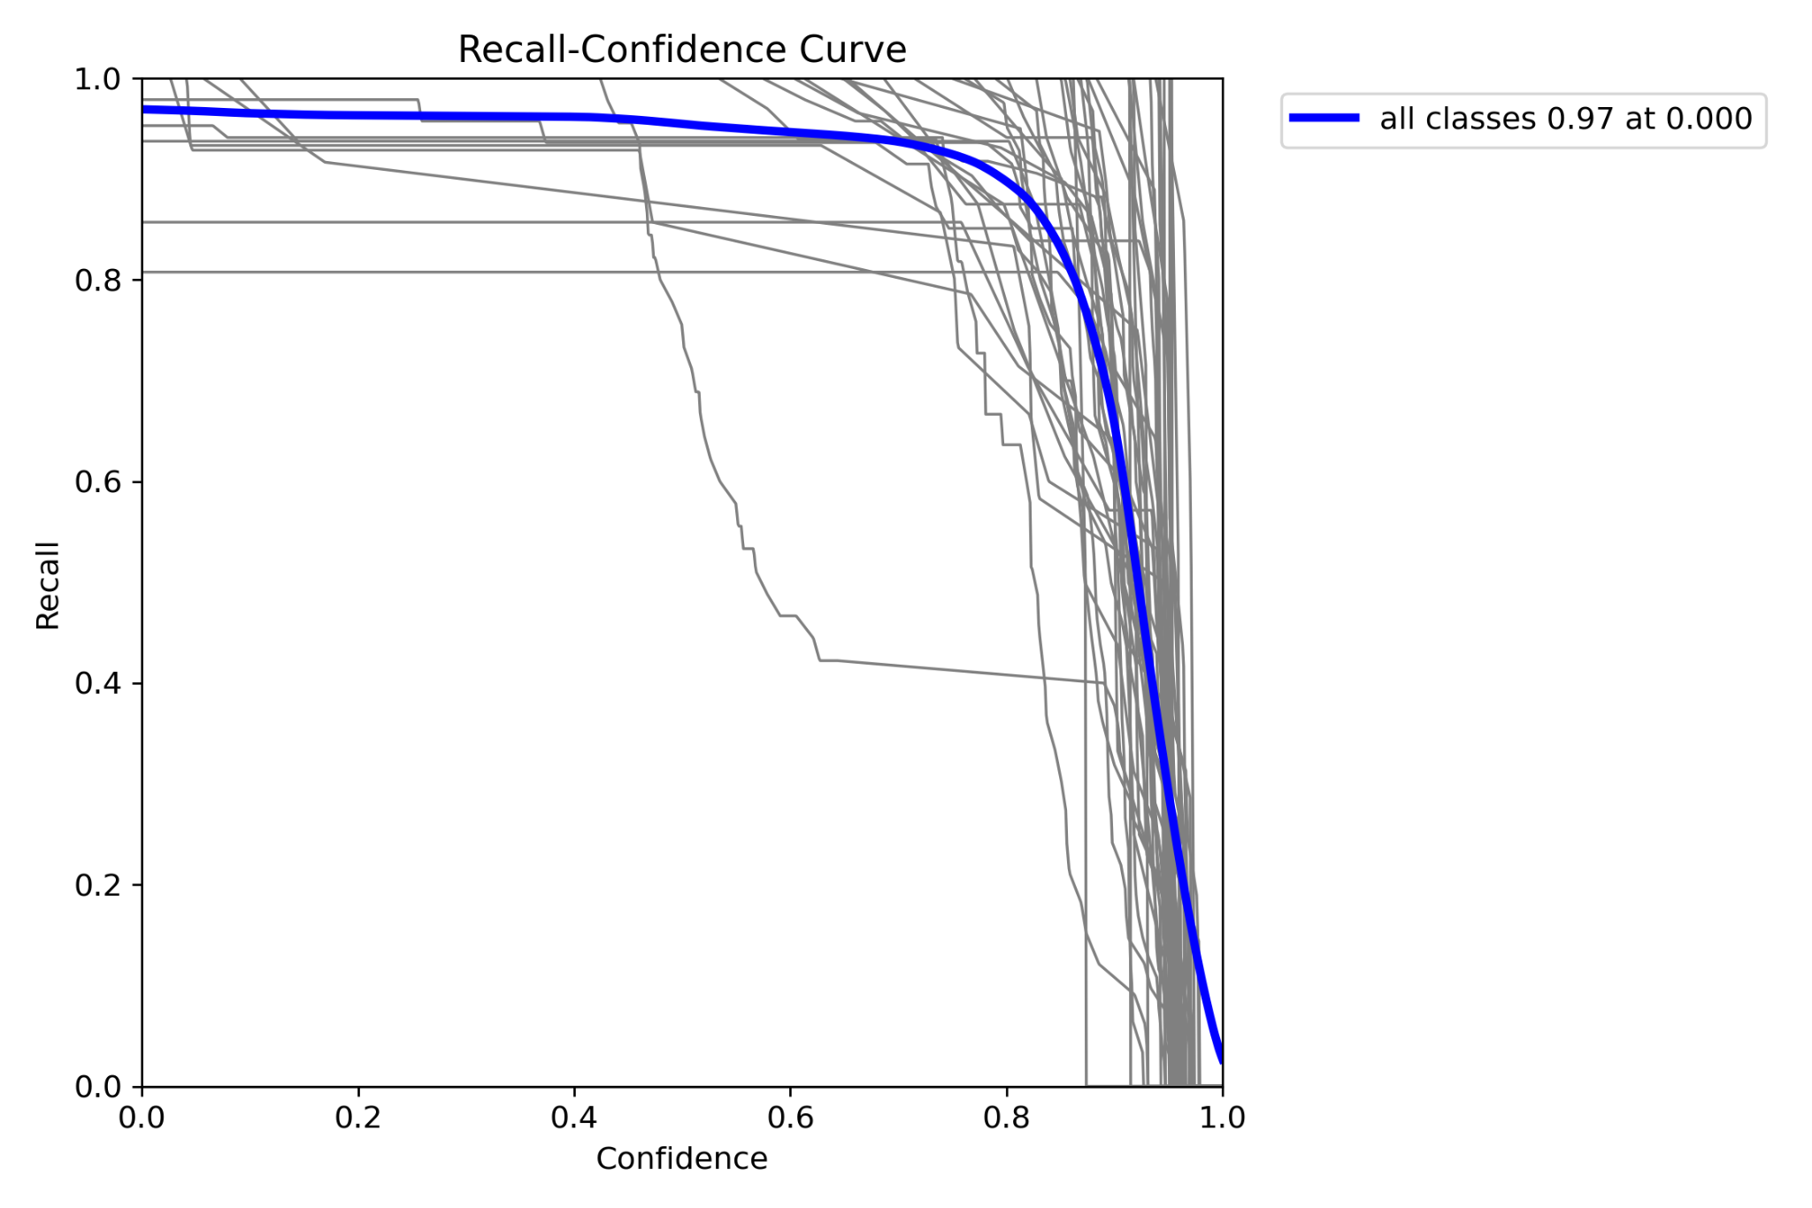
Results: Shelf Detection
Fig: Precision vs Recall Curve
Fig: Confidence Score Distribution for Top 10 Classes
Confidence score: majority of detections have high confidence scores, with most clustering around 0.9 and above, indicating strong model certainty.
mAP@0.5 = 0.958 indicates that our object detection model has very high accuracy at an IoU (Intersection over Union) threshold of 0.5.
Recall vs Confidence Curve

Slide 10
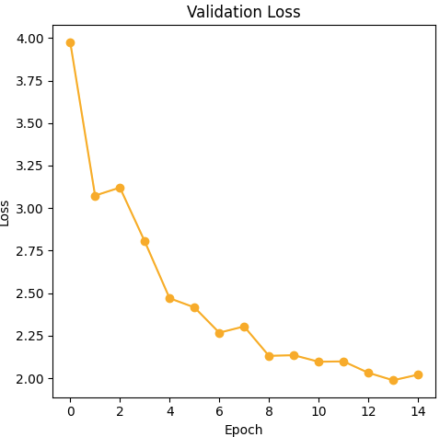
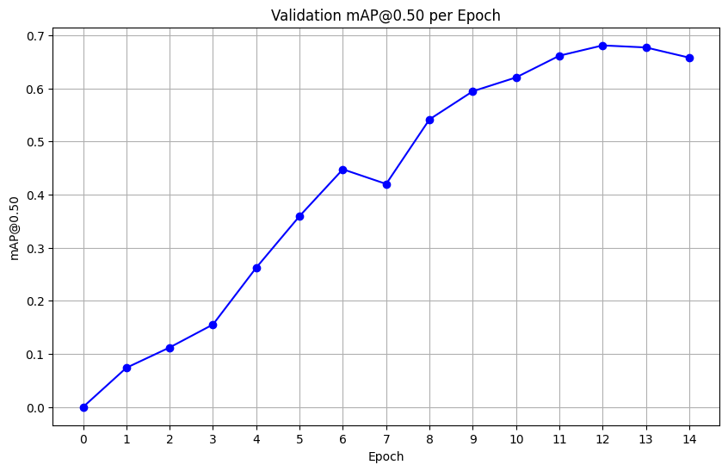
Results:Cart Detection
Validation mAP@0.50 steadily increases, indicating improved object detection accuracy as training progresses.
Validation loss decreases over epochs, reflecting better model fit and reduced prediction error on unseen data.

Slide 11
Results:Cart Detection
Metric | Baseline Model | Our Model | Which is Better
mAP | 0.4548 | 0.6470 | Our Model
Precision | 0.1882 | 0.0431 | Baseline
Recall | 0.5312 | 0.8894 | Our Model
F1 | 0.2693 | 0.0808 | Baseline
Our Model achieves a much higher mAP@0.50 (0.647 vs. 0.455), which is the standard for comparing object detection models and is generally the most important metric for overall performance.
Our Model also has much higher recall (0.889 vs. 0.531), meaning it finds almost all objects, but it's precision is much lower (0.043 vs. 0.188), indicating it produces more false positives.

Slide 12
Demonstration
Video Demo on Google Drive
Video comparing baseline model with our model to highlight accuracy improvement, memory buffer and handling of hidden objects.

Slide 13
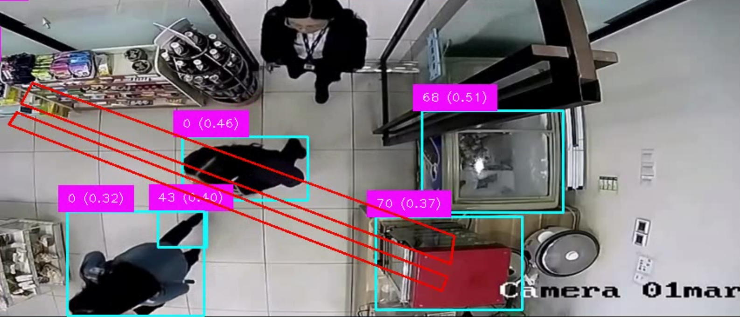
Demonstration
Blue bounding boxes identify objects (mainly people) and the red rectangles represents the hotzone which identifies the commonly traveled path between cooking packets and the heating appliances.

Slide 14
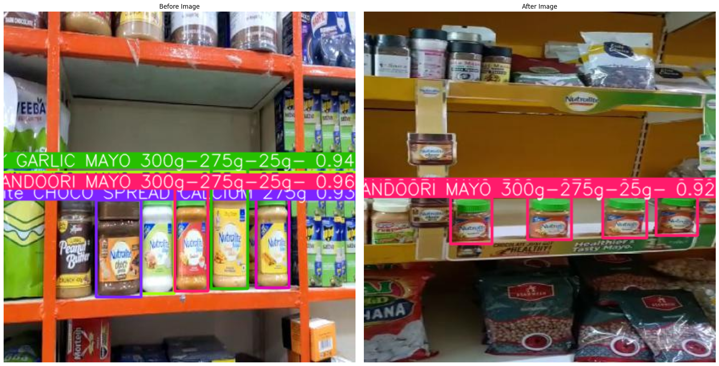
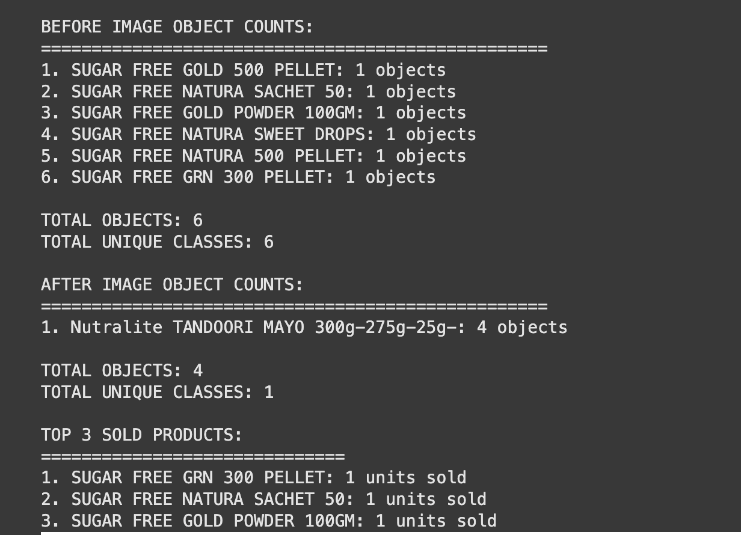
Demonstration
Product detection and count on before and after images.
Evaluation of top 3 sold products from the image analysis to identify most selling products.

Slide 15
Conclusion & Discussion
AI-powered shelf detection helps automate stock monitoring and ensures timely restocking.
Customer footfall analysis using video processing identifies hot zones and product interaction trends.
Smart cart detection allows for easy data-entries and a user friendly experience.
Combining video insights with sales data enhances decision-making, improves operations, and boosts revenue.
There are still edge cases like video disruption causing problems with memory buffer implementation issues on forward applications like heatmaps.
Our models could used a revamped UI which hides technical information and makes it more user friendly.
Our models could be implemented in a way that allows for a more seamless experience.
But, our models show improvement on baseline and combine to solve a variety of problems.

Slide 16

Thanks!
Questions? Feedback?
Please keep this slide for attribution

